Slide 1


sEnergy
Team 68

Slide 2

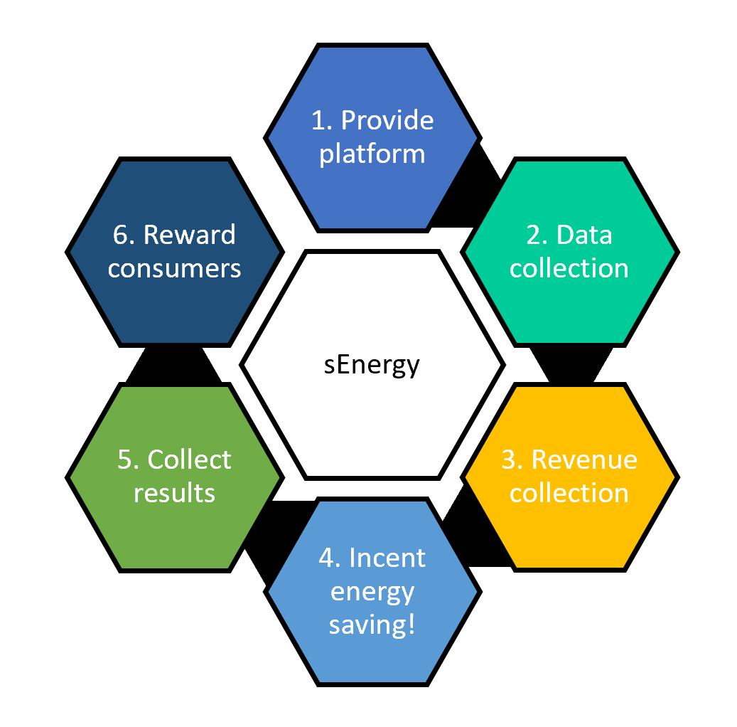



the idea
A platform to incent communities of consumers to save energy by providing financial and social rewards

Slide 3
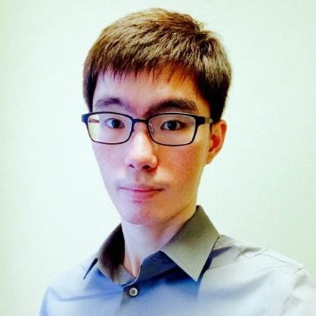
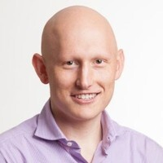
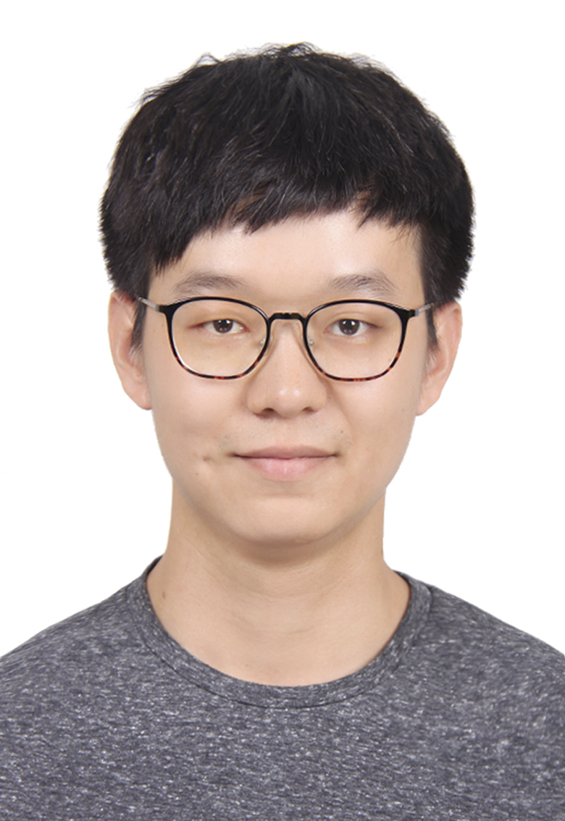
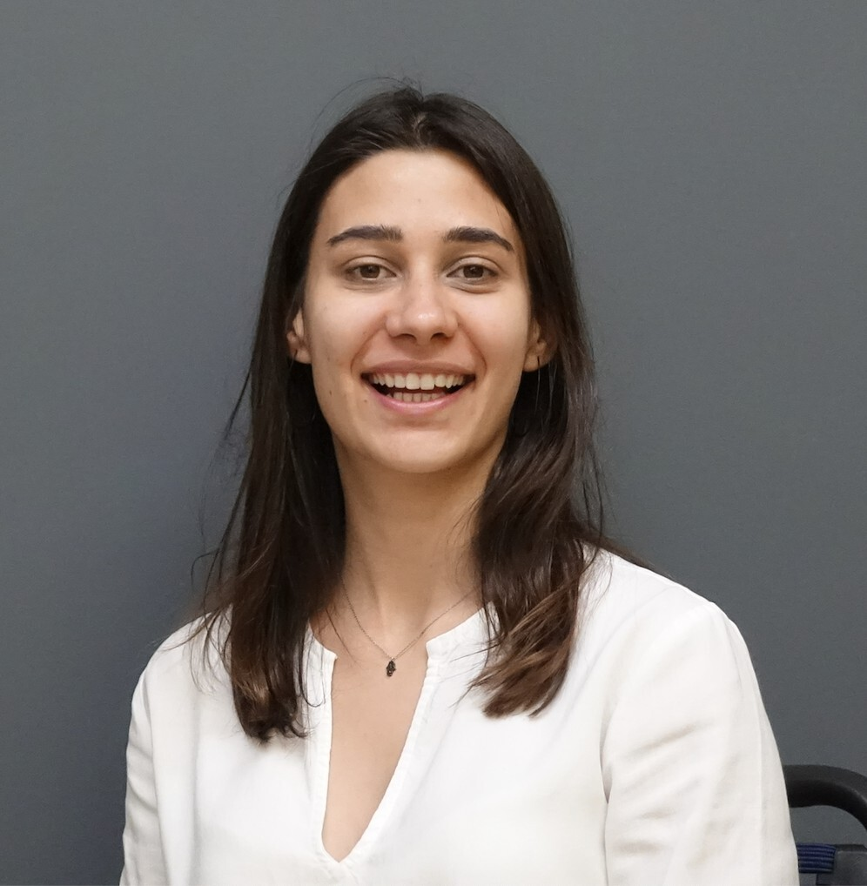


“How might we incent consumers to save energy?”
the team
Jay Lee
MBA
Jay Lee
MBA
Adam Levin
CS
Harry Jiahao Li
ORIE
Nilay Altun
CS
Ami Mehta
AAP

Slide 4
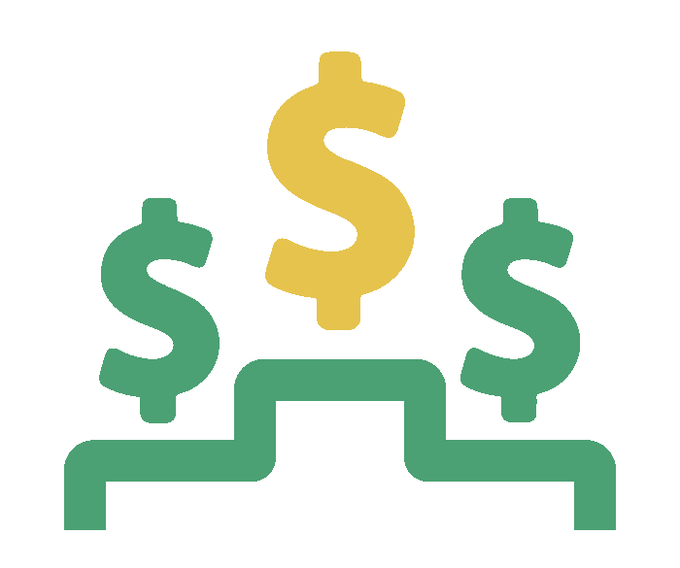
motivation

Slide 5
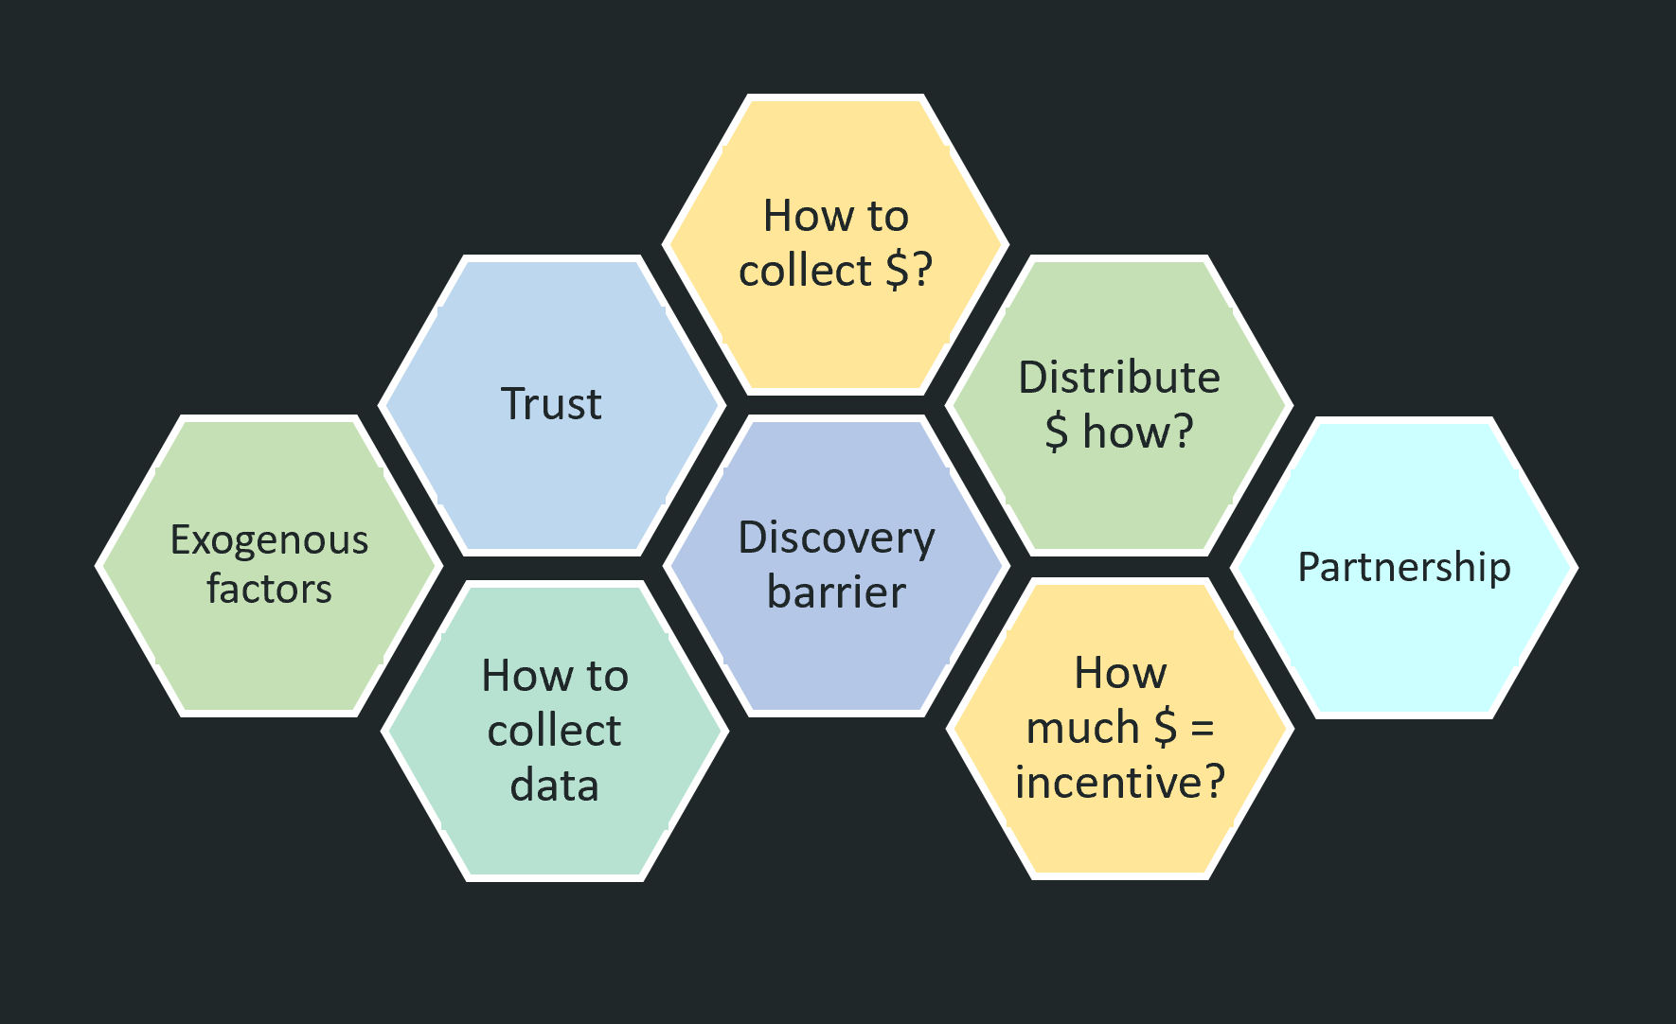


the risks

Slide 6

sequence
Experiment
Oct 26
Nov 2
Nov 9
Nov 16
Nov 21 Sprint #3
Prototype
Acquiring users
Gauging interest
Key:
Building
Experimenting
Prototype
Enough revenue
Monetizing ads
Equivalent experiment
Distribution strategy
Reducing screen-time
Research prototype
Partnership potential
Connect with utilities
Prototype
User trust
Collect utility bills
Equivalent experiment
Exogenous factors
Account for life events
Prototype
Openness to ads
Passive ad-viewing

Slide 7
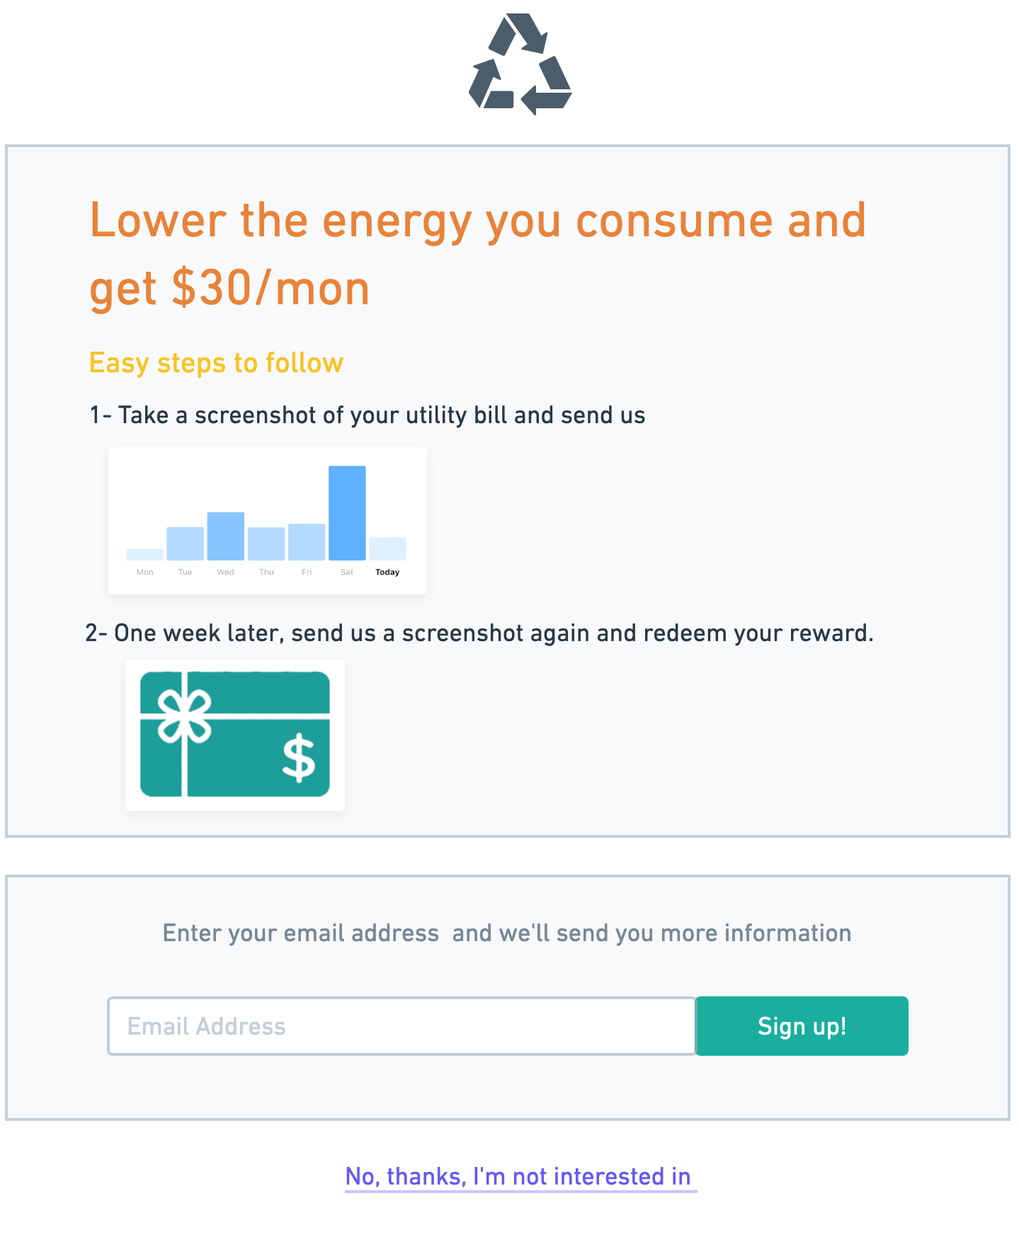
1. Do you wanna | gauging interest
Share your utility bill
Get your reward
Show us your interest

Slide 8



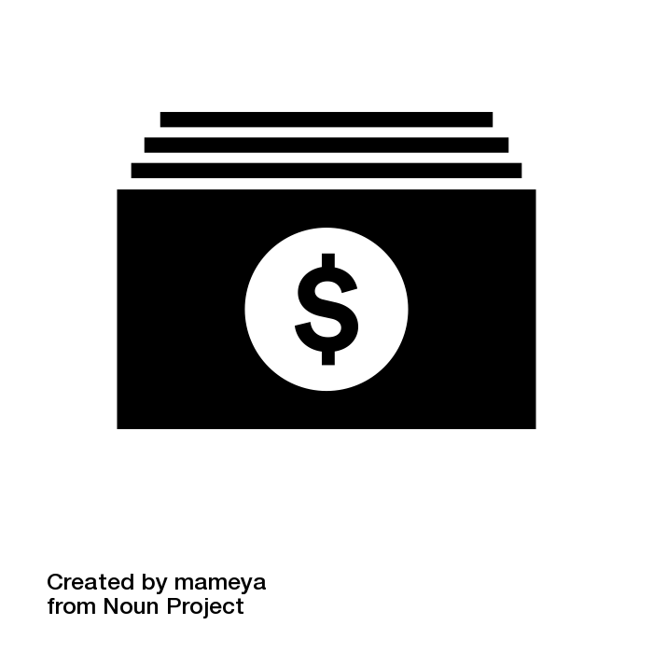


2. money money money | revenue & rewards
Watch 10 min /week
Cash
Prototype
Treatment Groups
Watch 15 min /week
Coupon
Analyse
Iterate
Watch 20 min /week
Giftcards
Notes:
Build a prototype that can show ads to the users
Divide participants into different treatment groups
Each group has a required level of commitment, based on amount of time spent watching ads
Rewards are given when users meet the expected commitment level at the end of the experiment, which is calculated based on expected ads revenue.

Slide 9

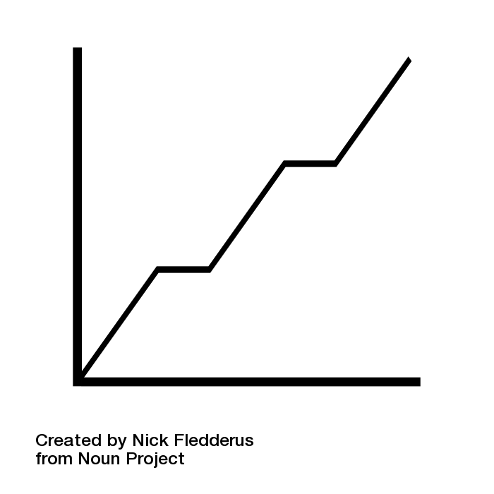
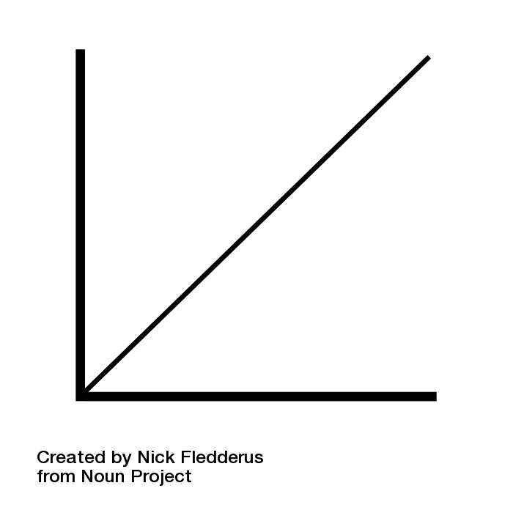
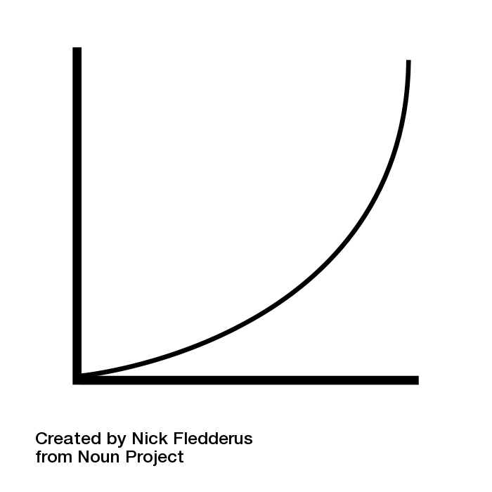
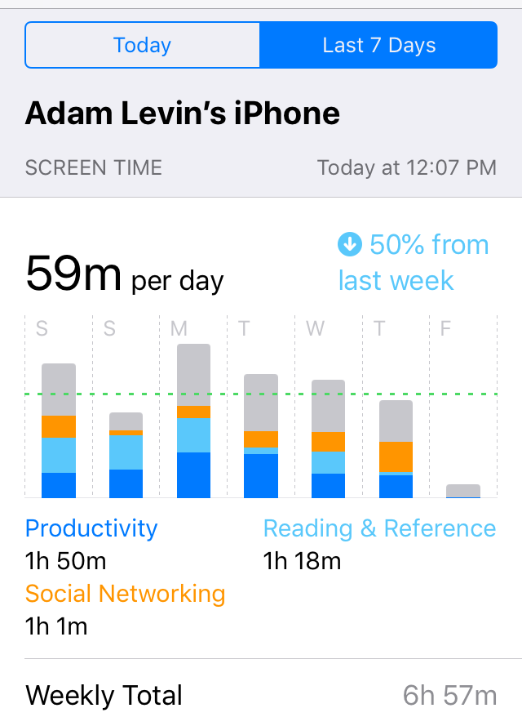


3. screen-time for muffins | distribution
Submit
Request
Expected Reward
Expected Reward
Expected Reward
1
Collect
Screenshots of Screen Time
Reduction
Reduction
Reduction
2
Distribute Rewards
4
Data
Analysis
3
Notes:
Initial participation rate/treatment group
Attrition rate/treatment group
Exogenous factors: variation in screen time across days

Slide 10
the risks

Slide 11
“How might we incent consumers to save energy?”
the team
Jay Lee
MBA
Jay Lee
MBA
Adam Levin
CS
Harry Jiahao Li
ORIE
Nilay Altun
CS
Ami Mehta
AAP

Slide 12
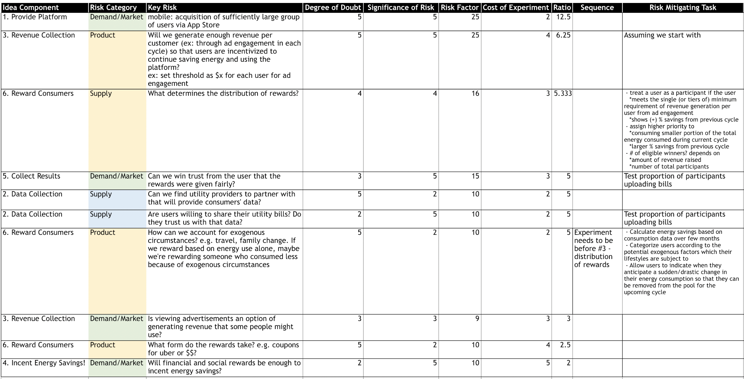
Appendix - Summary of De-risking Process

Slide 13
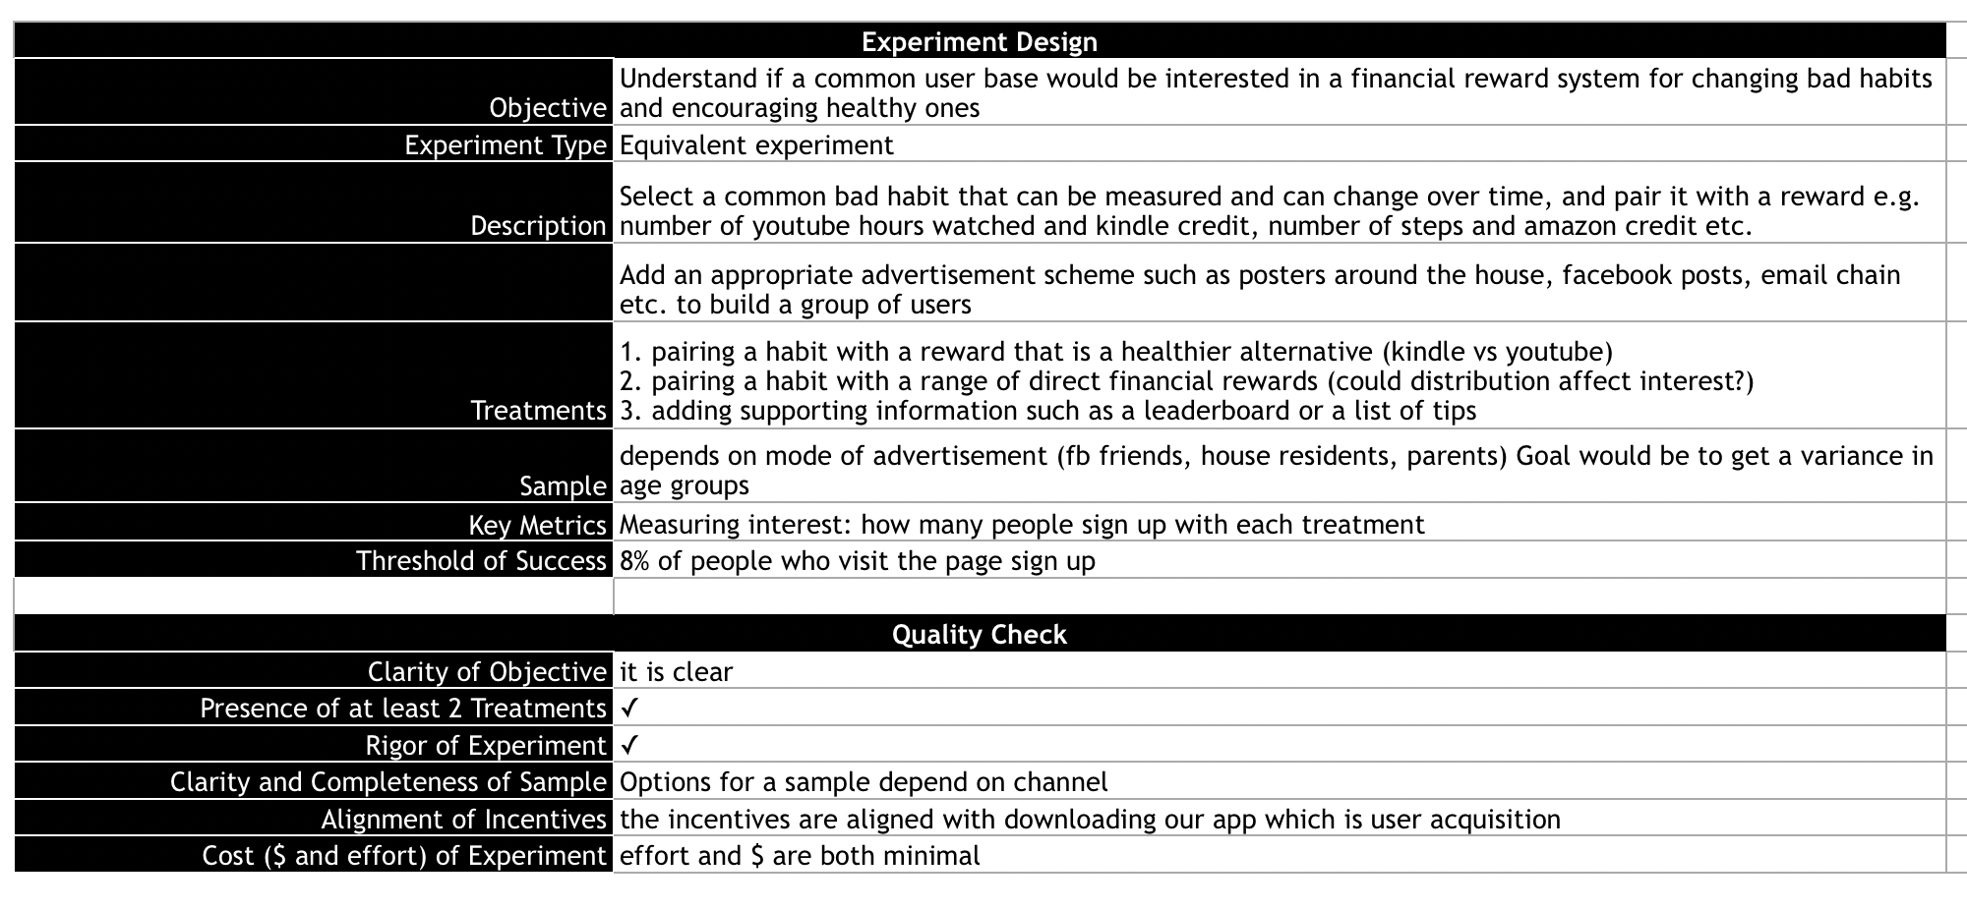
Appendix - Experiment 1

Slide 14
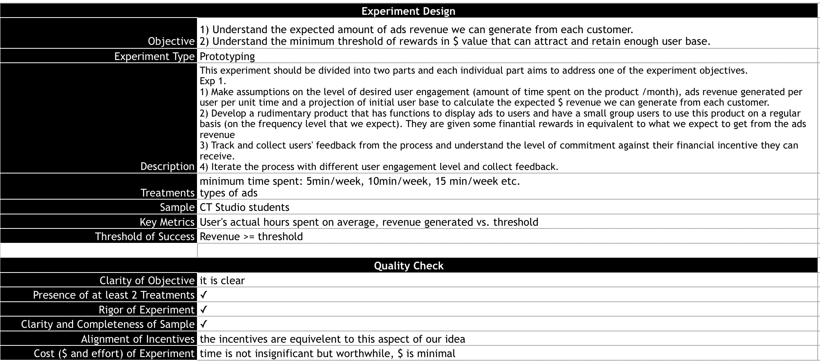
Appendix - Experiment 2

Slide 15
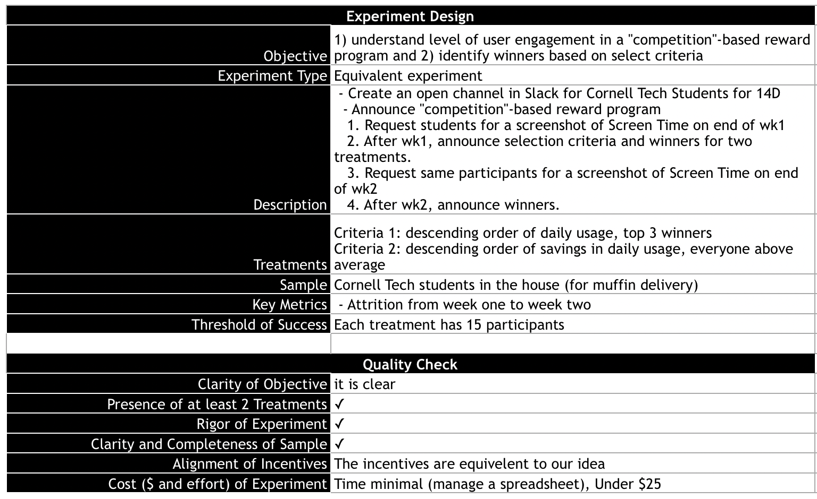
Appendix - Experiment 3

Slide 16
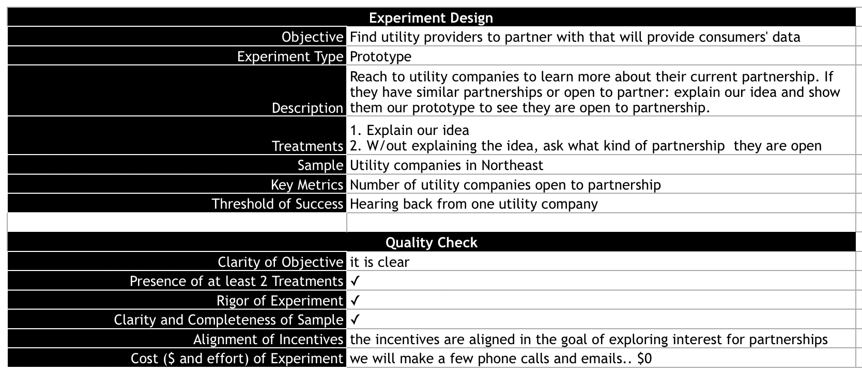
Appendix - Experiment 4

Slide 17
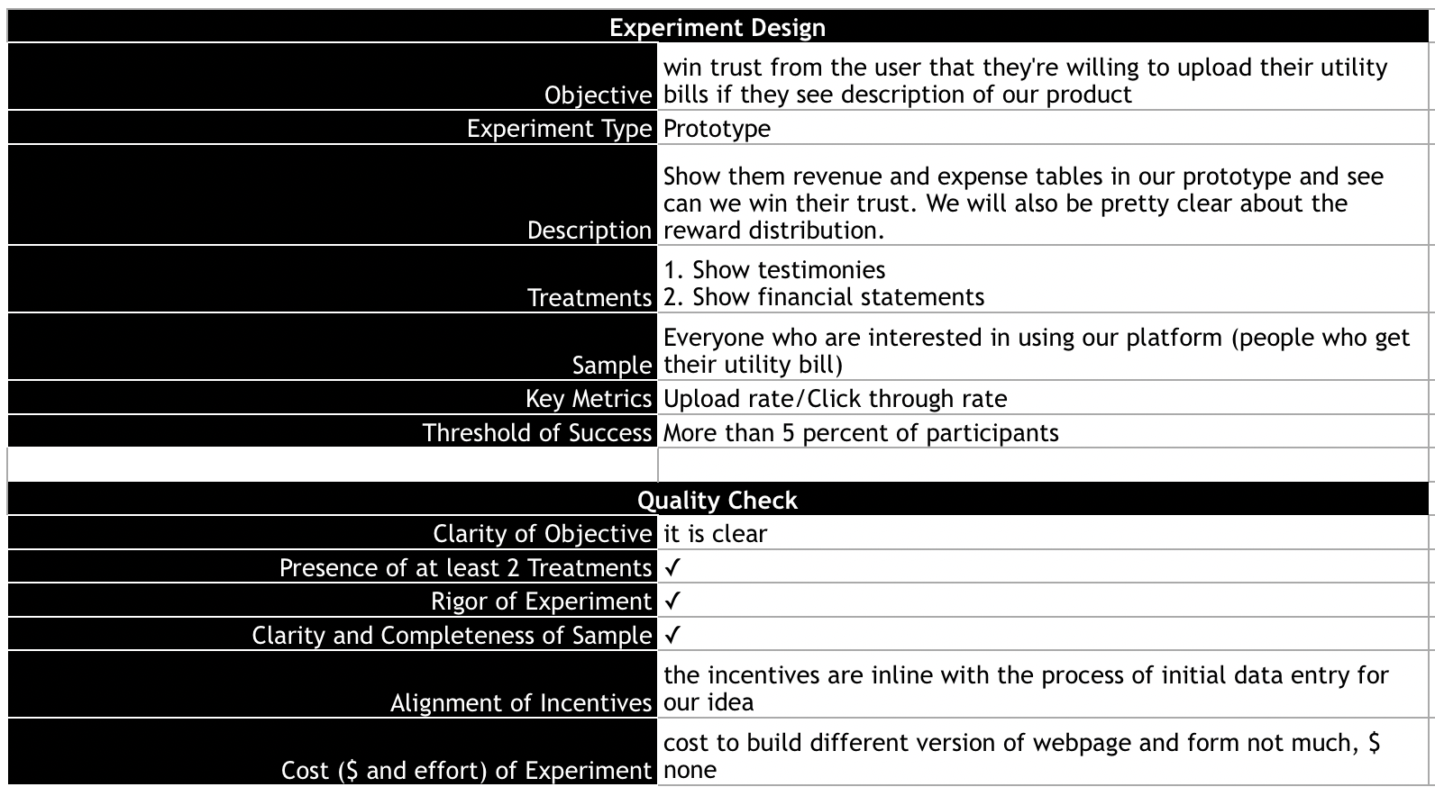
Appendix - Experiment 5

Slide 18
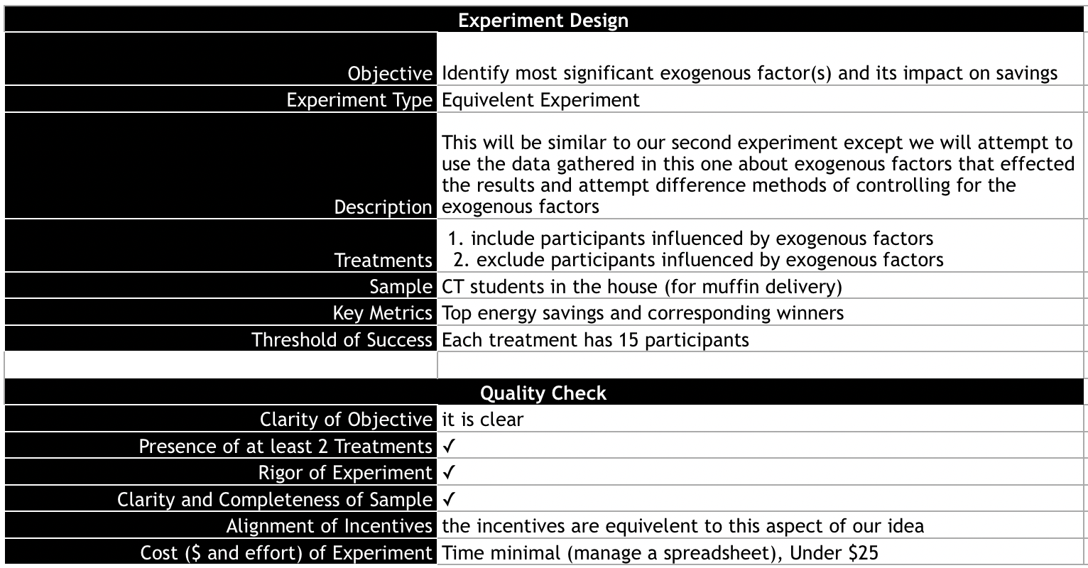
Appendix - Experiment 6

Slide 19
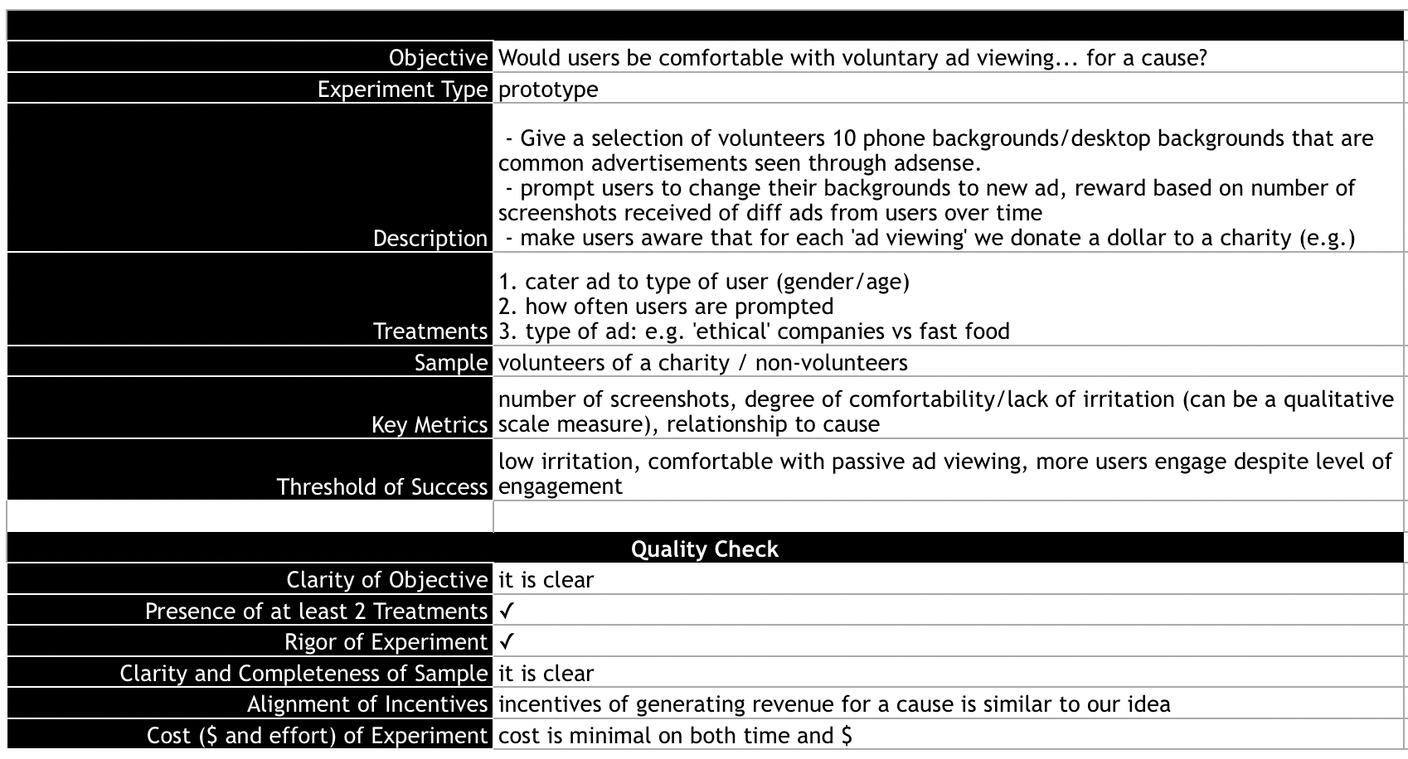
Appendix - Experiment 7

